Slide 1

Predictive Analytics
Flu Shot Prediction

Slide 2
Group Members
Team A
Name | Roll No
Akshay Amrit | E20004
Shivam Babbar | E20032
Shruti Nair | E20033
Aman Gupta | E20005
Rohit Umredkar | E20025
Arshan Khan | E20015
Prashantha Shivshankarrao | E20022

Slide 3
Introduction
H1N1 flu is also known as swine flu. It's called swine flu because in the past, the people who caught it had direct contact with pigs. That changed several years ago, when a new virus emerged that spread among people who hadn't been near pigs.
H1N1 influenza virus can spread from one person to another through small droplets of saliva that are expelled into the air when an infected person coughs or sneezes. The virus can also be passed through contact with objects the infected person has touched, such as a door handle or other surfaces.
In 2009, H1N1 was spreading fast around the world, so the World Health Organization called it a pandemic.

Slide 4
Objective
Vaccines to protect against 2009 H1N1 was available widely. CDC(Centers for Disease Control and Prevention) encouraged everyone to get vaccinated. Due to early availability of, and high demand for, seasonal flu vaccine, remaining supplies of seasonal vaccine was limited. So CDC continued to encourage those at highest risk from flu complications to seek seasonal flu vaccine and receive 2009 H1N1 vaccine, as recommended.
In this case study a survey was taken from set of people where in responses of questionnaire has been converted into dataset in order to to predict whether a person will/will not take the H1N1 vaccine or the Seasonal Flu vaccine.

Slide 5
Dataset Details
Following are the files
The trainingsetfeatures file consists of 36 features such as vaccine opinion, behavior of a person,number of children, family size etc.
The trainingsetlabels file consists of 2 columns one each for the ground truth values of whether a person took the H1N1 vaccine and Seasonal vaccine.
The testsetfeatures file consists of the same 36 features as that of the first file & the task is to predict probability of vaccination on this set of entries.

Slide 6
Data Dictionary
In this dataset there 36 variables. Few has been explained below rest variables are self explanatory →
respondent_id- Unique response id
h1n1_concern-the concern a person has about the virus
h1n1_knowledge-the knowledge they possess about the H1N1 virus
behavioral_antiviral_meds- do they believe in anti-vaccination
behavioral_avoidance- do they avoid roaming around in public
behavioral_face_mask-do they wear a face mask
behavioral_wash_hands-do they regularly wash their hands
behavioral_large_gatherings-do they tend to be in large gatherings
behavioral_outside_home-do they tend to be outdoors a lot
behavioral_touch_face-do they touch their faces often

Slide 7
Data Dictionary
census_msa-An MSA consists of one or more counties that contain a city of 50,000 or. more inhabitants and principal city is the core. City in a metropolitan area. The largest city in each metropolitan or micropolitan statistical area is designated a "principal city.“
MSA, Not Principle City 44%
MSA, Principle City 29%
chronic_med_condition- Whether they are having any past severe medical history
child_under_6_months- Whether the child is under 6 months
health_insurance – Whether they have health insurance
Age group – Following are the age group 18-34,35-44,45-54,55-64,65+
Opinion for
opinion_h1n1_vacc_effective- Opinion on whether the h1n1 vaccine is effective
opinion_h1n1_sick_from_vac- Opinion on whether one gets sick from h1n1 vaccine in short side effect of vaccine opinion_seas_vacc_effective- Opinion on whether the whether the seasonal vaccine is effective
opinion_seas_sick_from_vac- Opinion on whether one gets sick from seasonal vaccine in short side effect of vaccine

Slide 8
Data with Seasonal FLU Context

Slide 9
Data with H1N1 Context

Slide 10
Personal Data

Slide 11
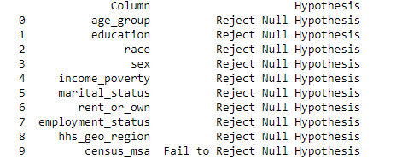
Chi-Square Test
Significance of variables- Represented by Chi-sq or p-value indicates the impact of the independent variable on the dependent variable
Chi-sq Null Hypothesis Value of estimate=0
Effectively meaning that the variable is not significant to determine the value of Y variable
Here census_msa variable has very little effect on target Variable. Hence removed from feature selection

Slide 12
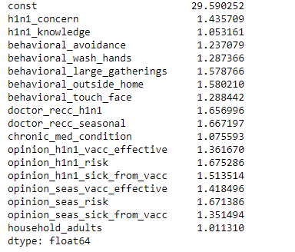
Whether the variables are multi collinear?
Multi collinearity is a statistical phenomenon where two or more variables are correlated with each other.
As Multi collinearity rises, the ability to define any variable’s effect is diminished.
This will make estimation of effect of individual variable difficult and unreliable
It could lead to inclusion of non relevant variables in the multi variate analysis result
To verify this whether there is multi collinearity we have used VIF test to check.
It observed that all variables are independent variable

Slide 13
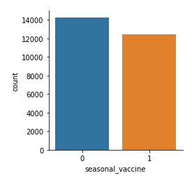
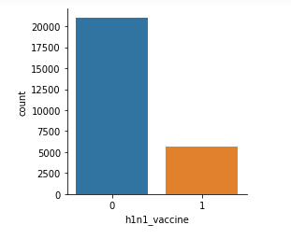
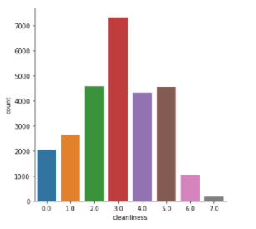
This graph most of them will not take h1n1 vaccine. May be due to side effects
We have added all behavioural variables –(behavioral_antiviral_meds,behavioral_avoidance,behavioral_face_mask,behavioral_wash_hands,behavioral_large_gatherings,behavioral_outside_home,behavioral_touch_face.) in to one variable cleanliness and plot the graph
People with cleanliness 2 or above are more likely to get vaccinated than the rest.

Slide 14
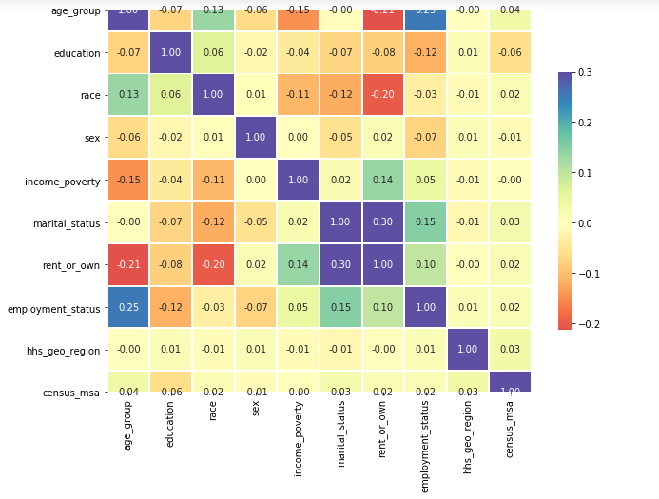
From heatmap it is observed that education, race, sex,martialstatus,rent_or_own,hhs_geo_region and census MSA should be removed from final feature selection.

Slide 15
MODEL EVALUATION
Vaccine Type | Model | Training_ accuracy | Test_ accuracy | F1_score_ train | F1_score_test | Recall_train | Recall_test | Precision_train | Precision_test | AUC-ROC
Seasonal FLU Vaccine | Logistic Regression | 0.77 | 0.77 | 0.77 | 0.77 | 0.77 | 0.77 | 0.77 | 0.77 | 0.84
 | XGBOOST | 0.58 | 0.57 | 0.51 | 0.50 | 0.58 | 0.57 | 0.76 | 0.74 | 0.85
 | RANDOM FOREST | 0.77 | 0.77 | 0.77 | 0.77 | 0.77 | 0.77 | 0.77 | 0.77 | 0.84
 | LGBM CLASSIFIER | 0.81 | 0.78 | 0.81 | 0.78 | 0.81 | 0.78 | 0.81 | 0.78 | 0.85

Slide 16
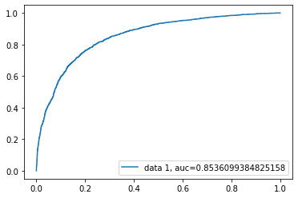
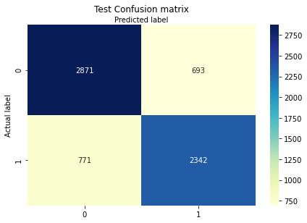
Seasonal FLU
LGBM classifier gives the best predictions.
We could see LGBM striking a balance between False Positives and False Negatives in the confusion matrix.

Slide 17
MODEL EVALUATION
Vaccine Type | Model | Training_ accuracy | Test_ accuracy | F1_score_ train | F1_score_test | Recall_train | Recall_test | Precision_train | Precision_test | AUC-ROC
H1N1 Vaccine | Logistic Regression | 0.83 | 0.83 | 0.82 | 0.81 | 0.83 | 0.83 | 0.82 | 0.81 | 0.82
 | XGBOOST | 0.60 | 0.58 | 0.63 | 0.62 | 0.60 | 0.58 | 0.83 | 0.82 | 0.83
 | RANDOM FOREST | 0.83 | 0.83 | 0.81 | 0.80 | 0.83 | 0.83 | 0.82 | 0.81 | 0.82
 | LGBM CLASSIFIER | 0.86 | 0.84 | 0.85 | 0.82 | 0.86 | 0.84 | 0.86 | 0.82 | 0.83

Slide 18
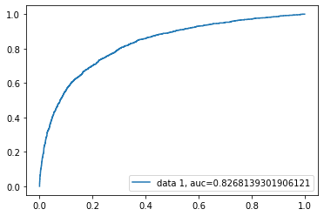
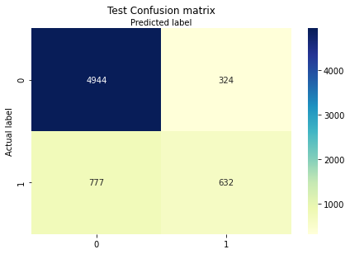
H1N1 Vaccine
LGBM classifier gives the best AUC-ROC score.
Dataset being the imbalanced one we could see LGBM trying to closer between False Positives and False Negatives in the confusion matrix than any other model.

Slide 19
THANK YOU

